Slide 1

New LJ Institute of Engineering and Technology
Name :Ritu Patel
Roll Number(Batch) : 68 B12
Department : CSE(AIML) / IT
Topic : Data Analytics and Visualization
with Tableau(Engineering+)

Slide 2
COVID-19 DATASOURCE
[ Attach snapshots with tooltip for each of the following ]
Create a dashboard with worldwide map, confirmed, recovered and death analysis.
Create a dashboard with nationwide map, confirmed, recovered and death analysis for a specific country.
Apply “Hover” action filter on a selected country to create interactive dashboard.
Apply “Select” action highlight on a selected state to create interactive dashboard.
Change the granularity level to years in both worldwide and nationwide dashboards.

Slide 3
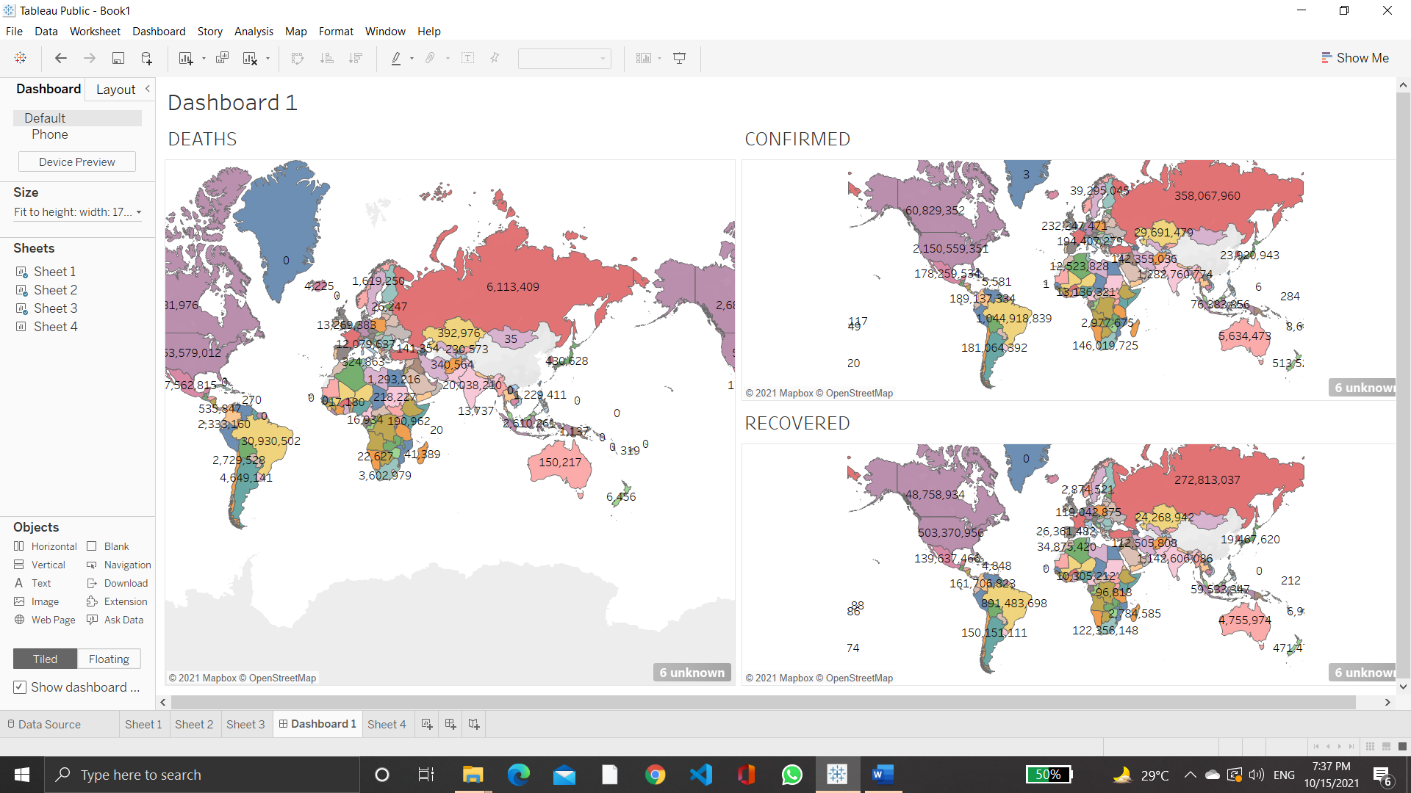
COVID-19 DATASOURCE
Create a dashboard with worldwide map, confirmed, recovered and death analysis.

Slide 4
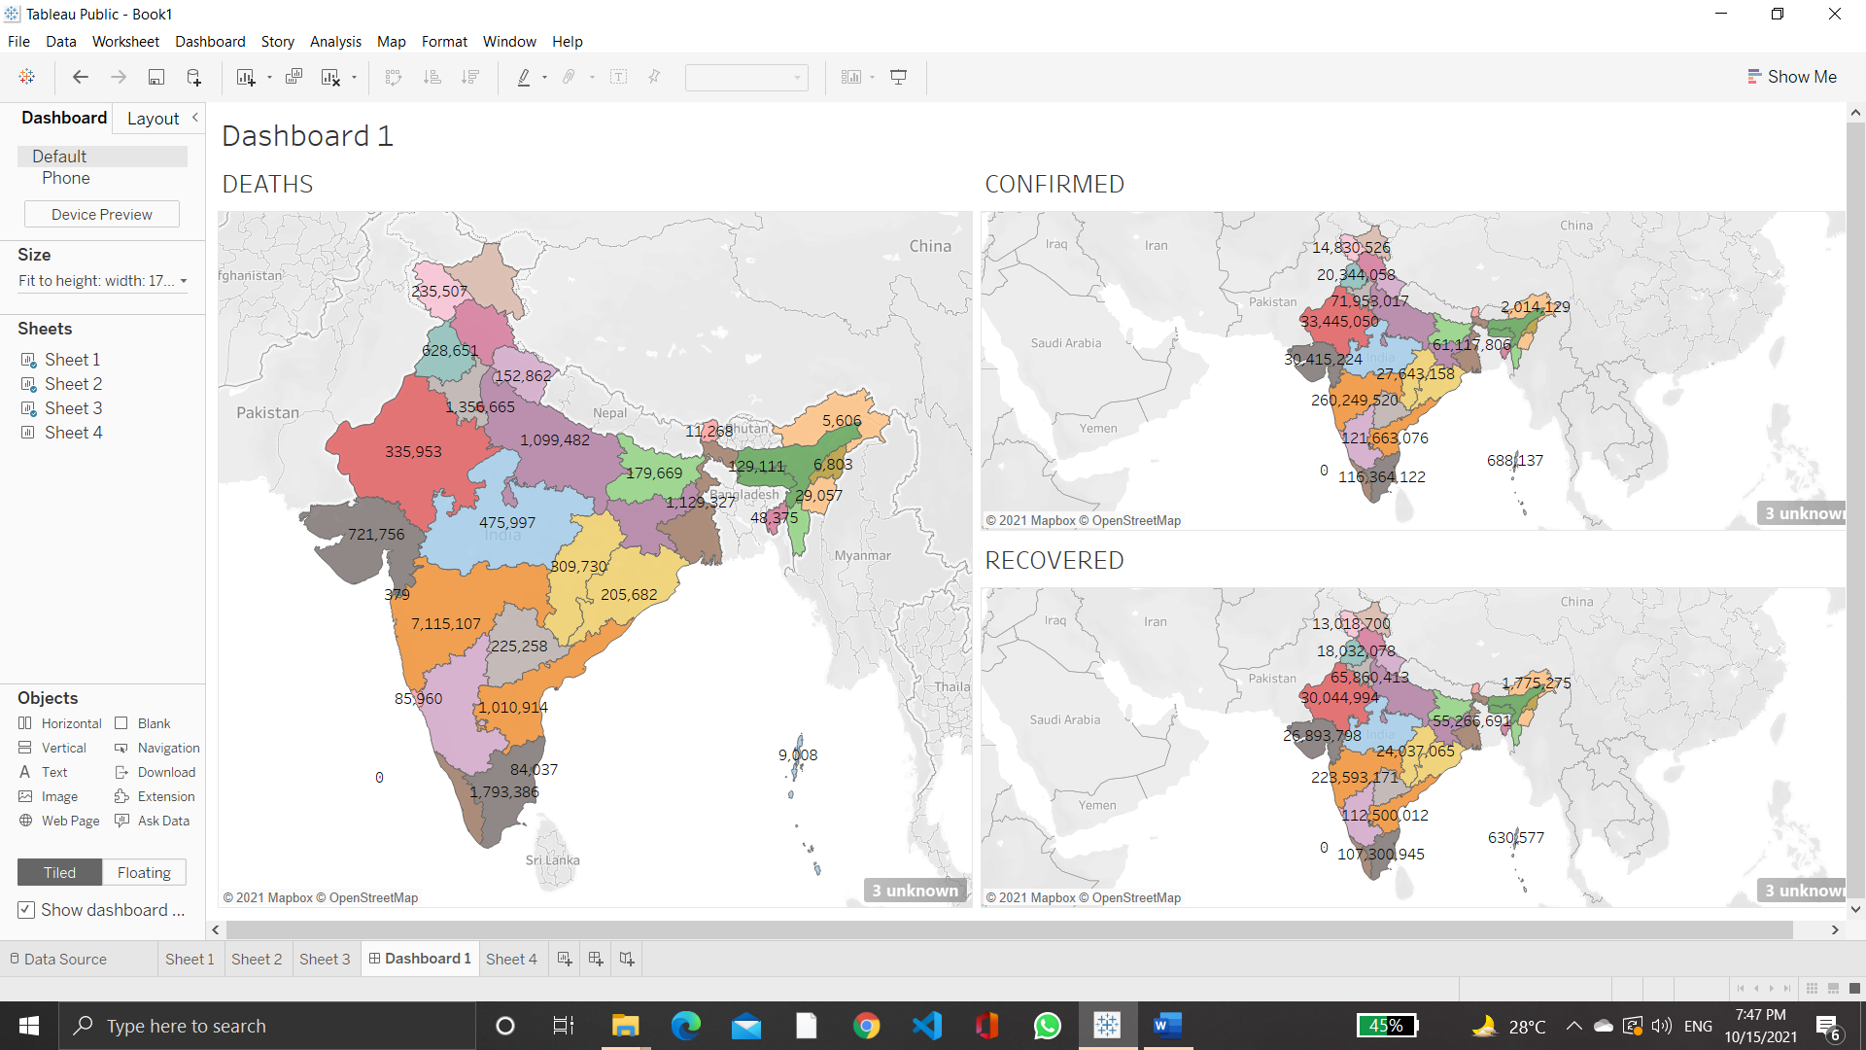
Create a dashboard with nationwide map, confirmed, recovered and death analysis for a specific country.

Slide 5
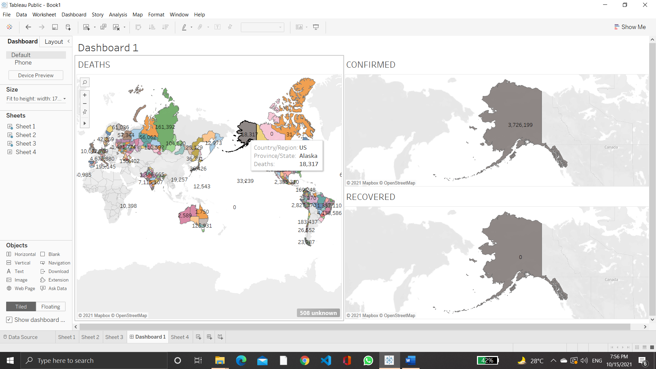
Apply “Hover” action filter on a selected country to create interactive dashboard.

Slide 6
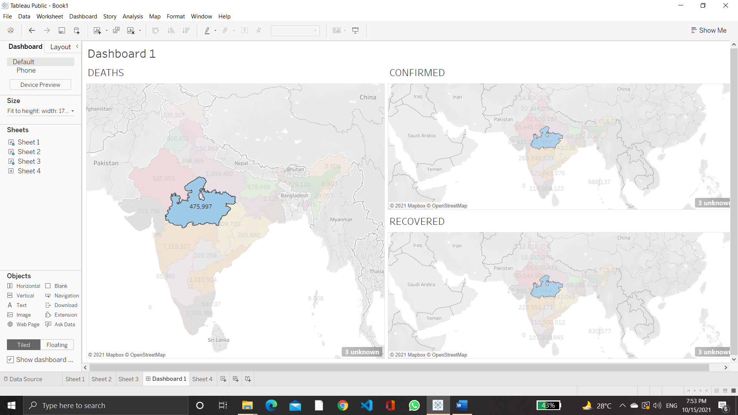
Apply “Select” action highlight on a selected state to create interactive dashboard.

Slide 7
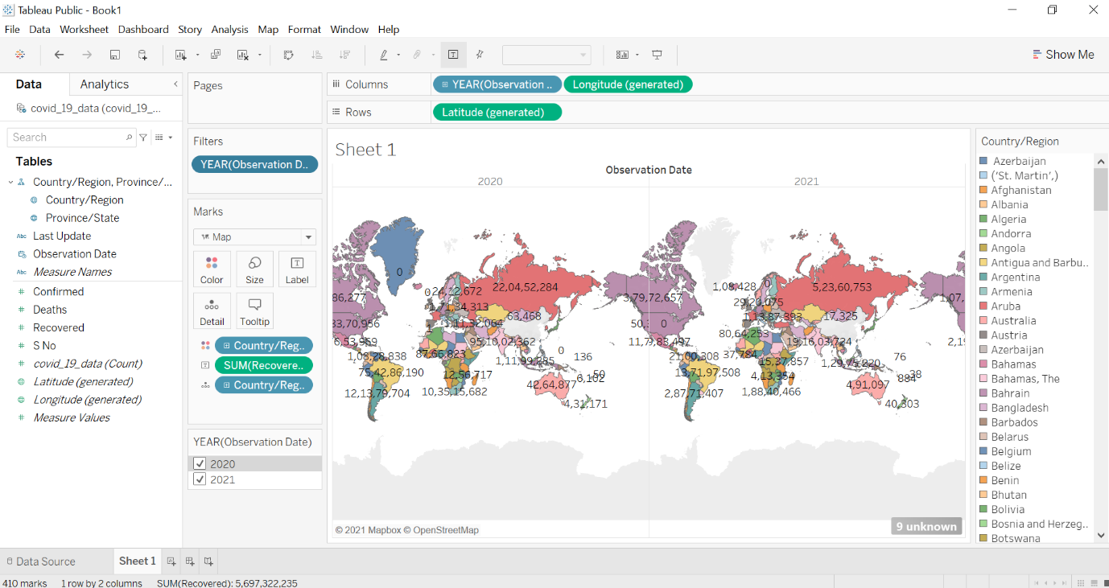
Change the granularity level to years in both worldwide and nationwide dashboards.

Slide 8
SUPERSTORE DATASOURCE
[use label formatting for sales and use color palette to distinguish years 2015-2018]
Find the aggregate sales for each month of a year using area chart
Find the aggregate profit for each quarter of a year 2015-2018 using area chart
Plot sales and profit for each month of a year in furniture category
Plot sales and profit for each month of a year in office supplies category in central region
Create interactive dashboard with appropriate graphs and charts using action filters, images and label formatting.

Slide 9
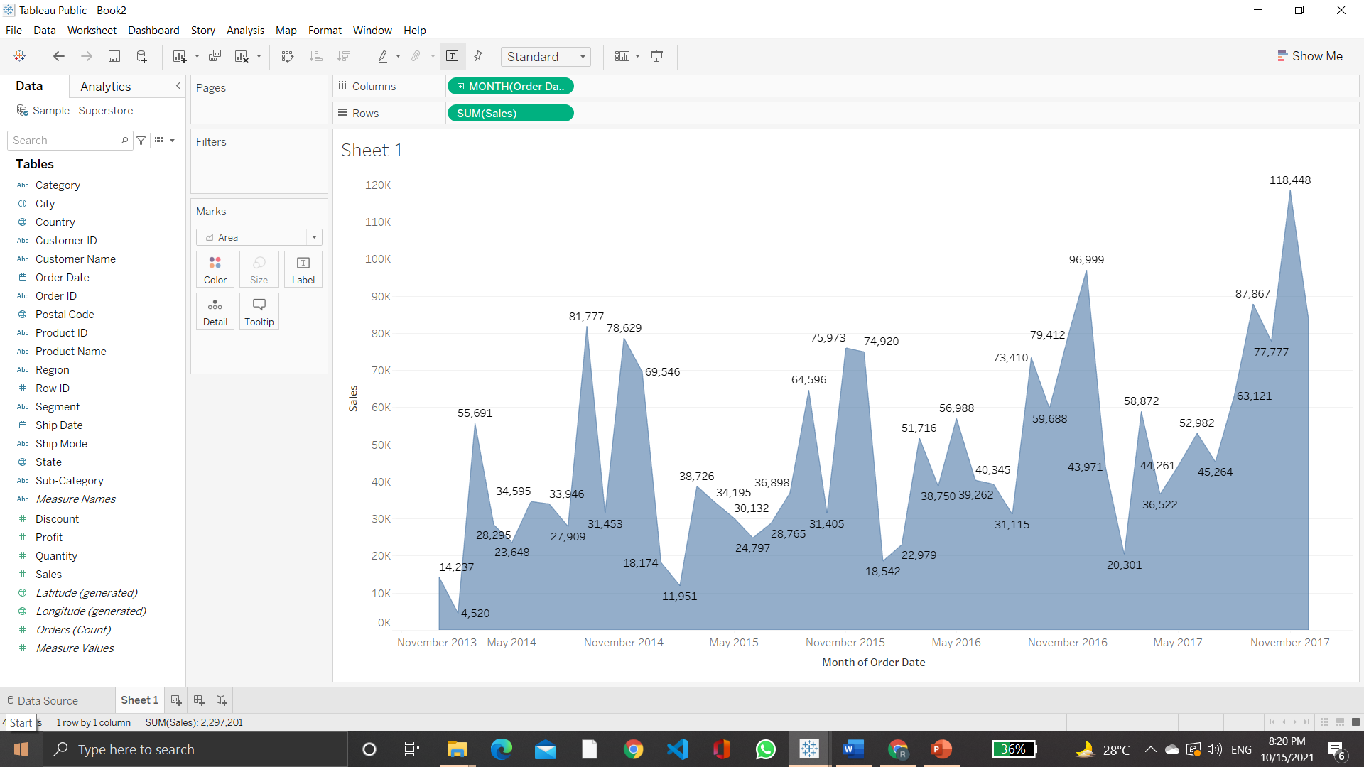
SUPERSTORE DATASOURCE Find the aggregate sales for each month of a year using area chart

Slide 10
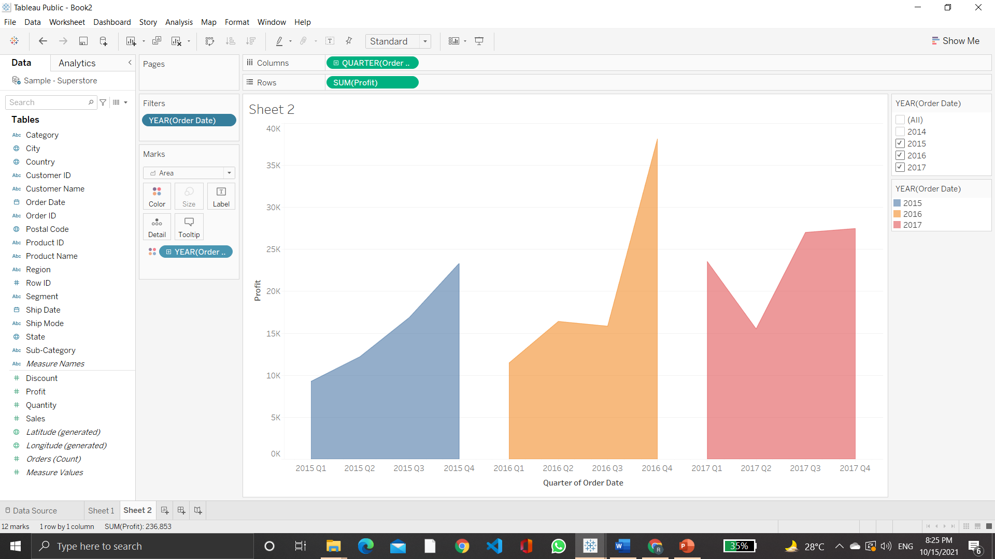
Find the aggregate profit for each quarter of a year 2015-2018 using area chart

Slide 11
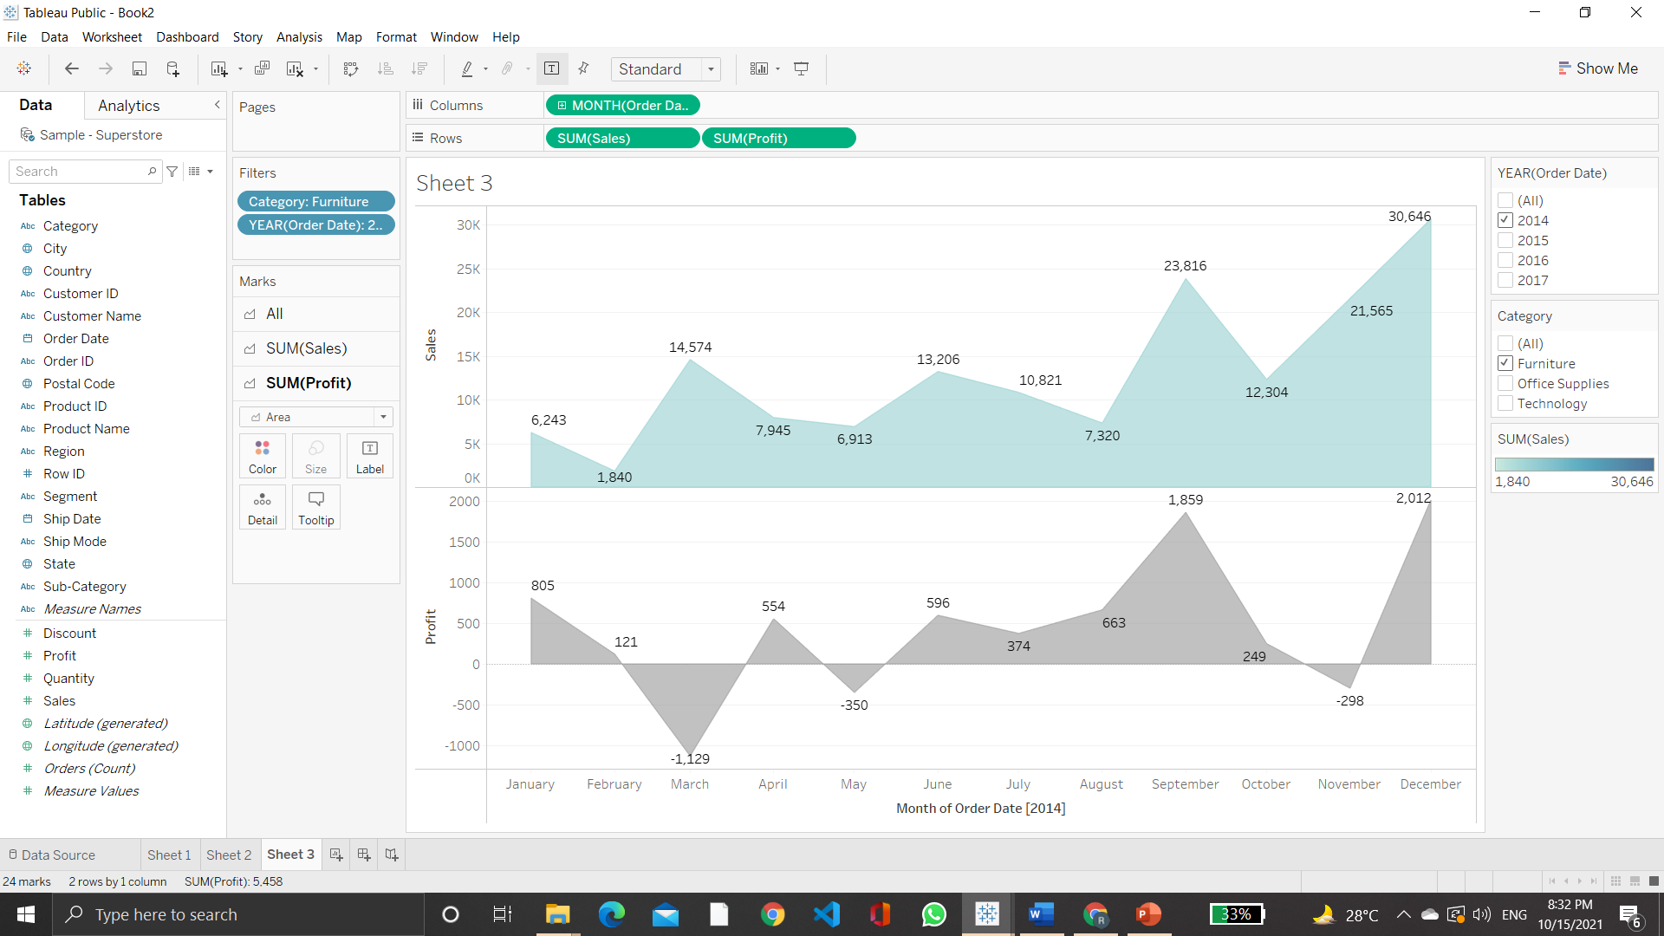
Plot sales and profit for each month of a year in furniture category

Slide 12
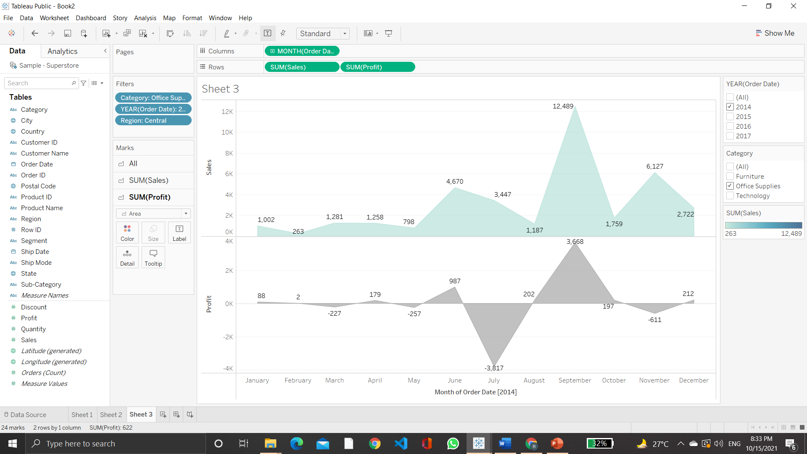
Plot sales and profit for each month of a year in office supplies category in central region

Slide 13
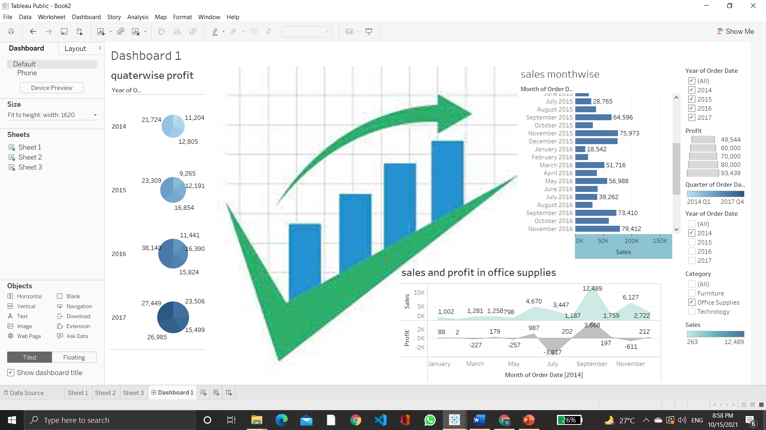
Create interactive dashboard with appropriate graphs and charts using action filters, images and label formatting.

Slide 14
NETFLIX DATASOURCE
[Use appropriate data joining and blending]
1.Plot synchronized dual axis chart (line and area) for count of netflix titles of India for release year 2000-2020.
2.Plot Bubble chart of netflix titles for each year by using single value slider filter for both movie and TV show.
3. Plot the tree map graph to find count of netflix titles for “Action and Adventure” category for united states.
4. Plot movie count of specific country as per different ratings.
5. Plot count of TV shows for different categories using side-by-side bars.
6. Create dual axis area charts for Movies and TV shows for years 2014-2020.
7. Create a dashboard with the most useful insights

Slide 15
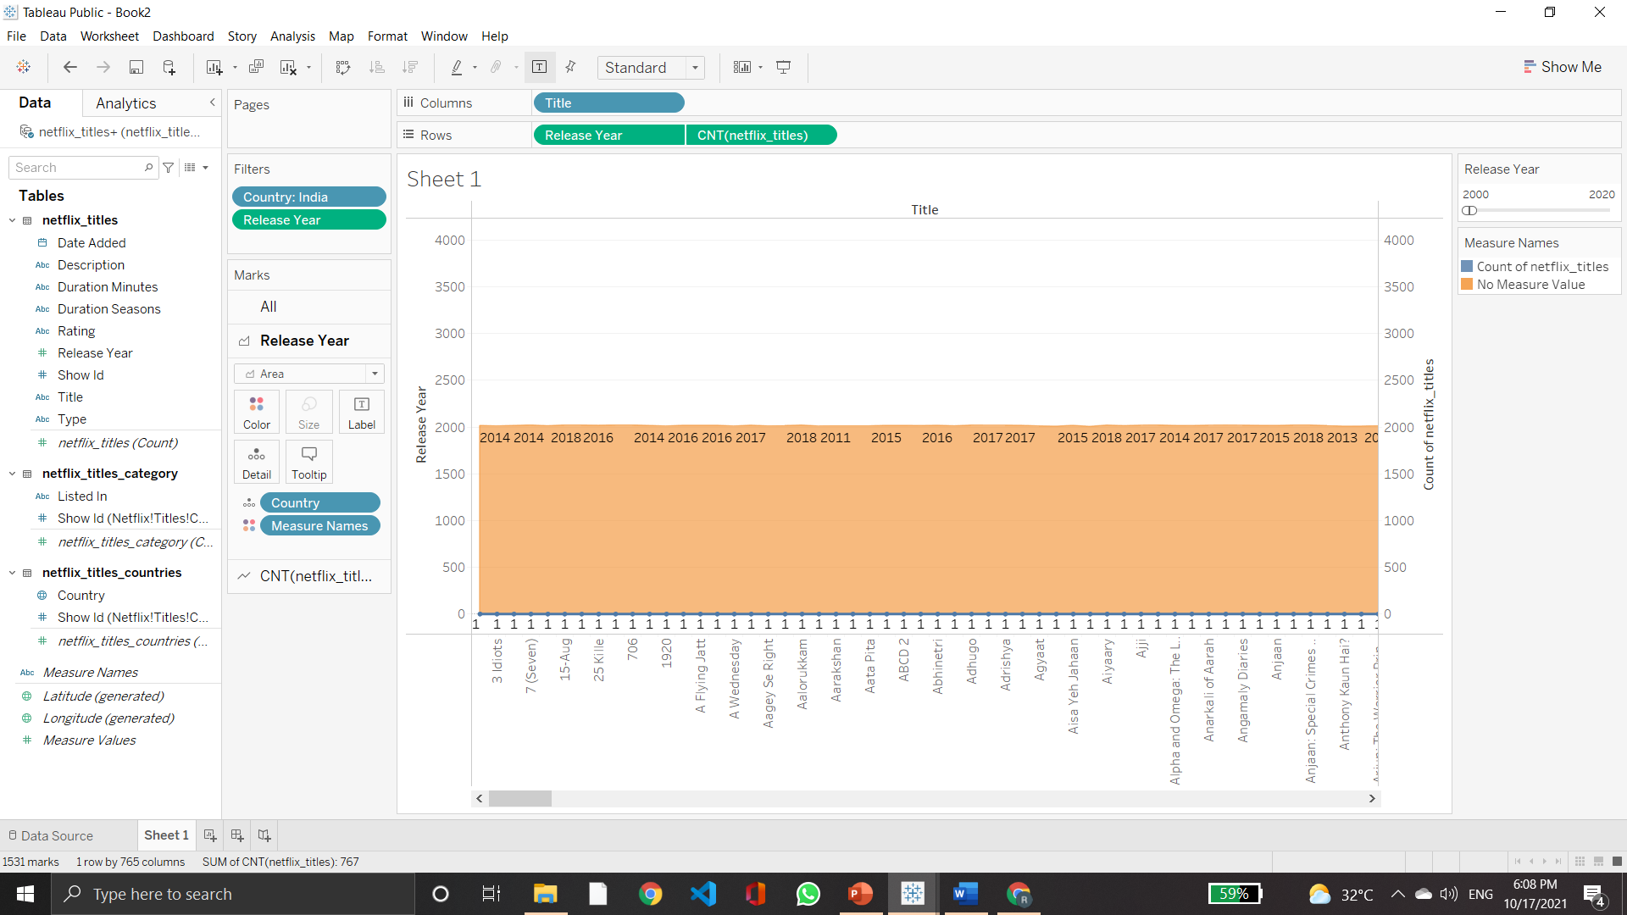
NETFLIX DATASOURCE Plot synchronized dual axis chart (line and area) for count of netflix titles of India for release year 2000-2020.

Slide 16
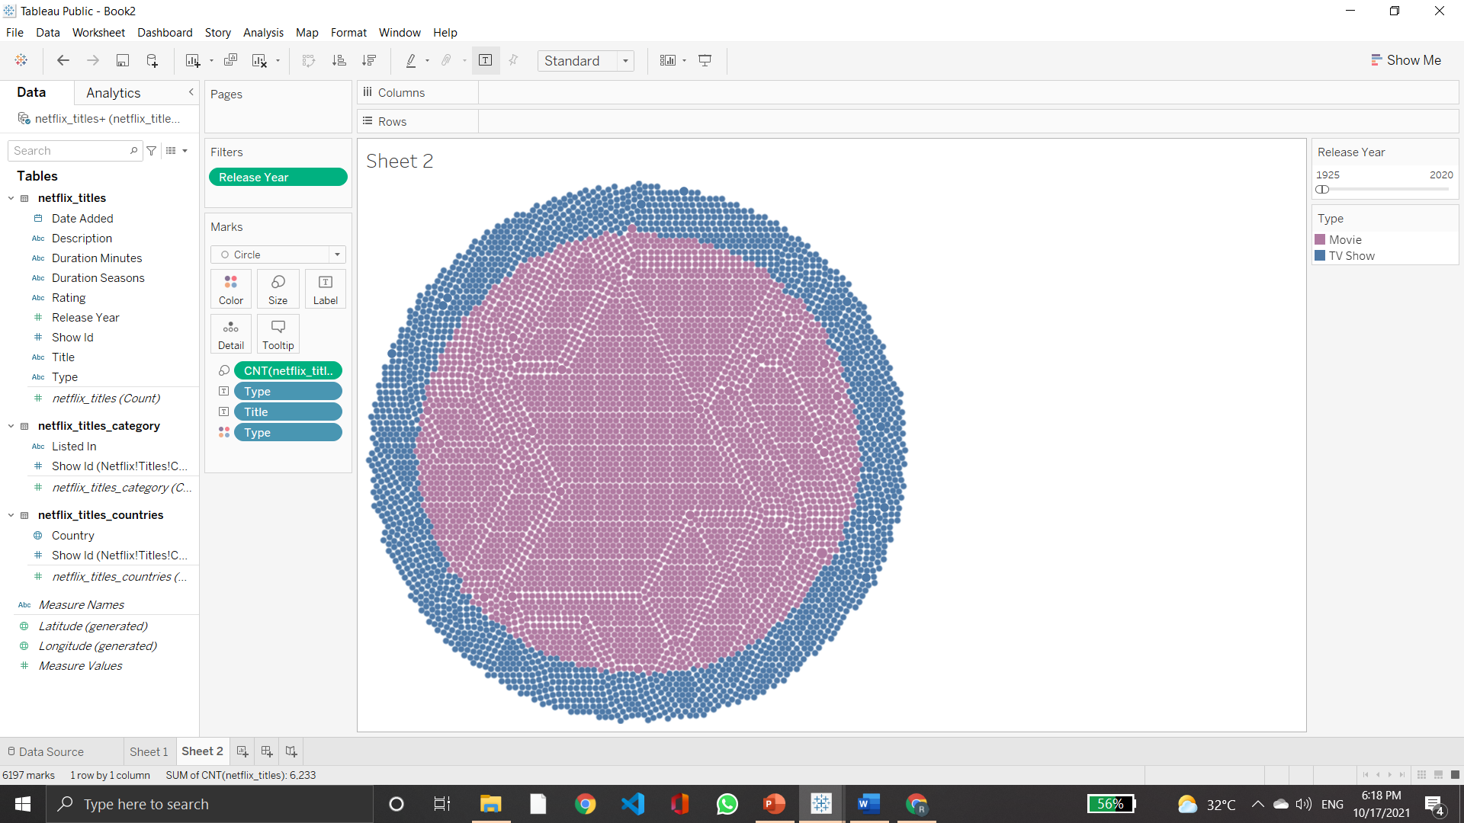
Plot Bubble chart of netflix titles for each year by using single value slider filter for both movie and TV show.

Slide 17
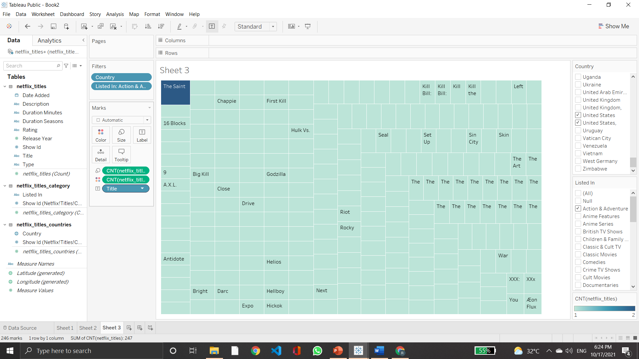
Plot the tree map graph to find count of netflix titles for “Action and Adventure” category for united states.

Slide 18
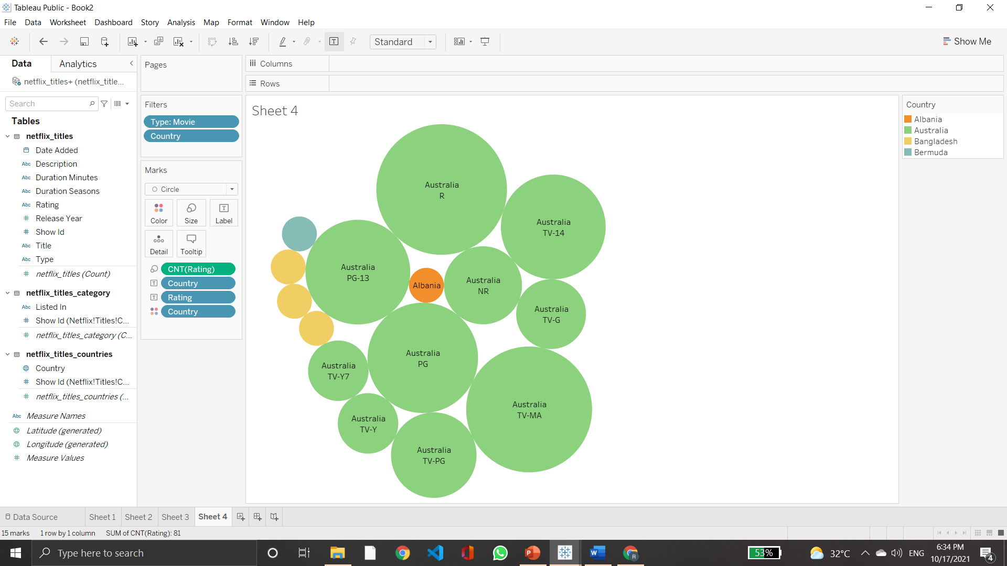
Plot movie count of specific country as per different ratings.

Slide 19
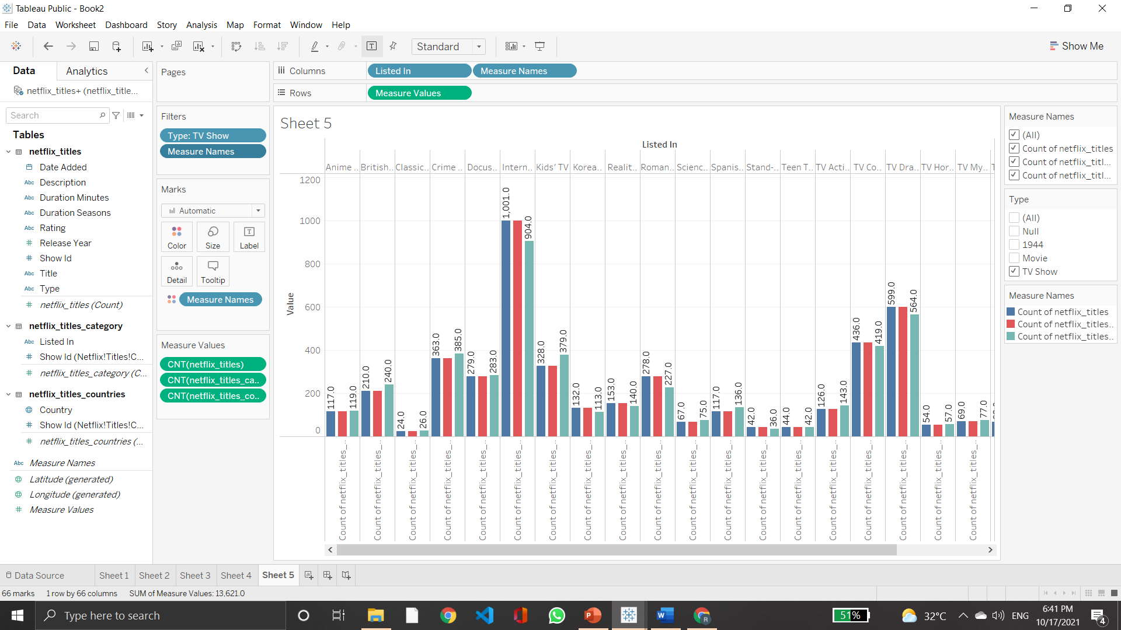
Plot count of TV shows for different categories using side-by-side bars.

Slide 20
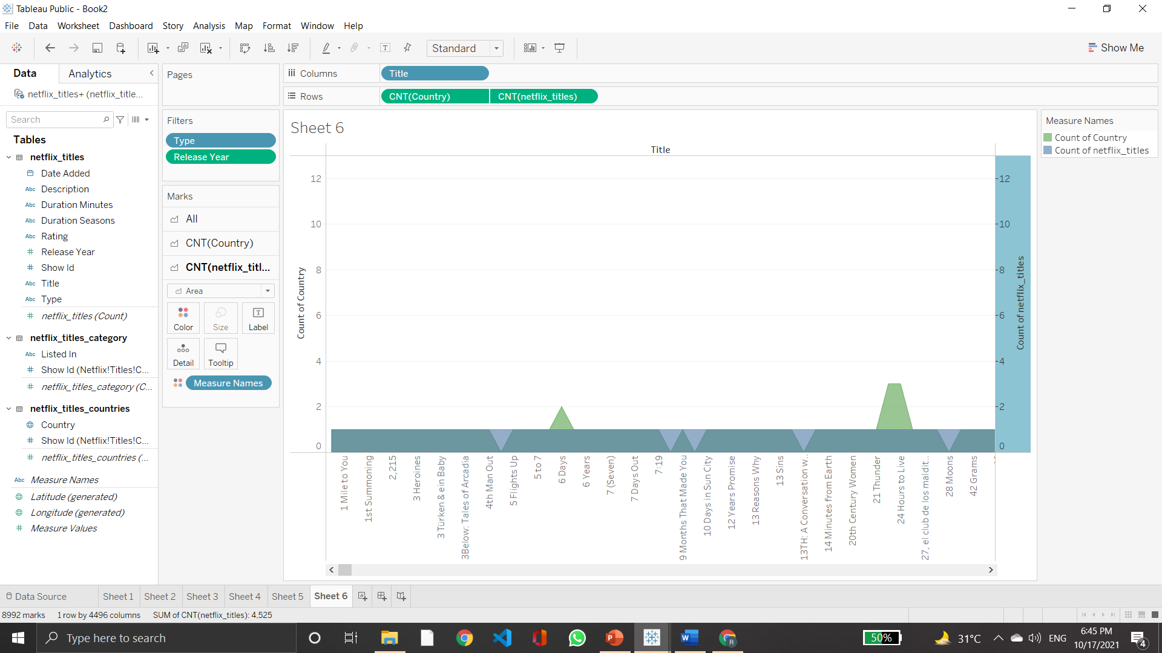
Create dual axis area charts for Movies and TV shows for years 2014-2020

Slide 21
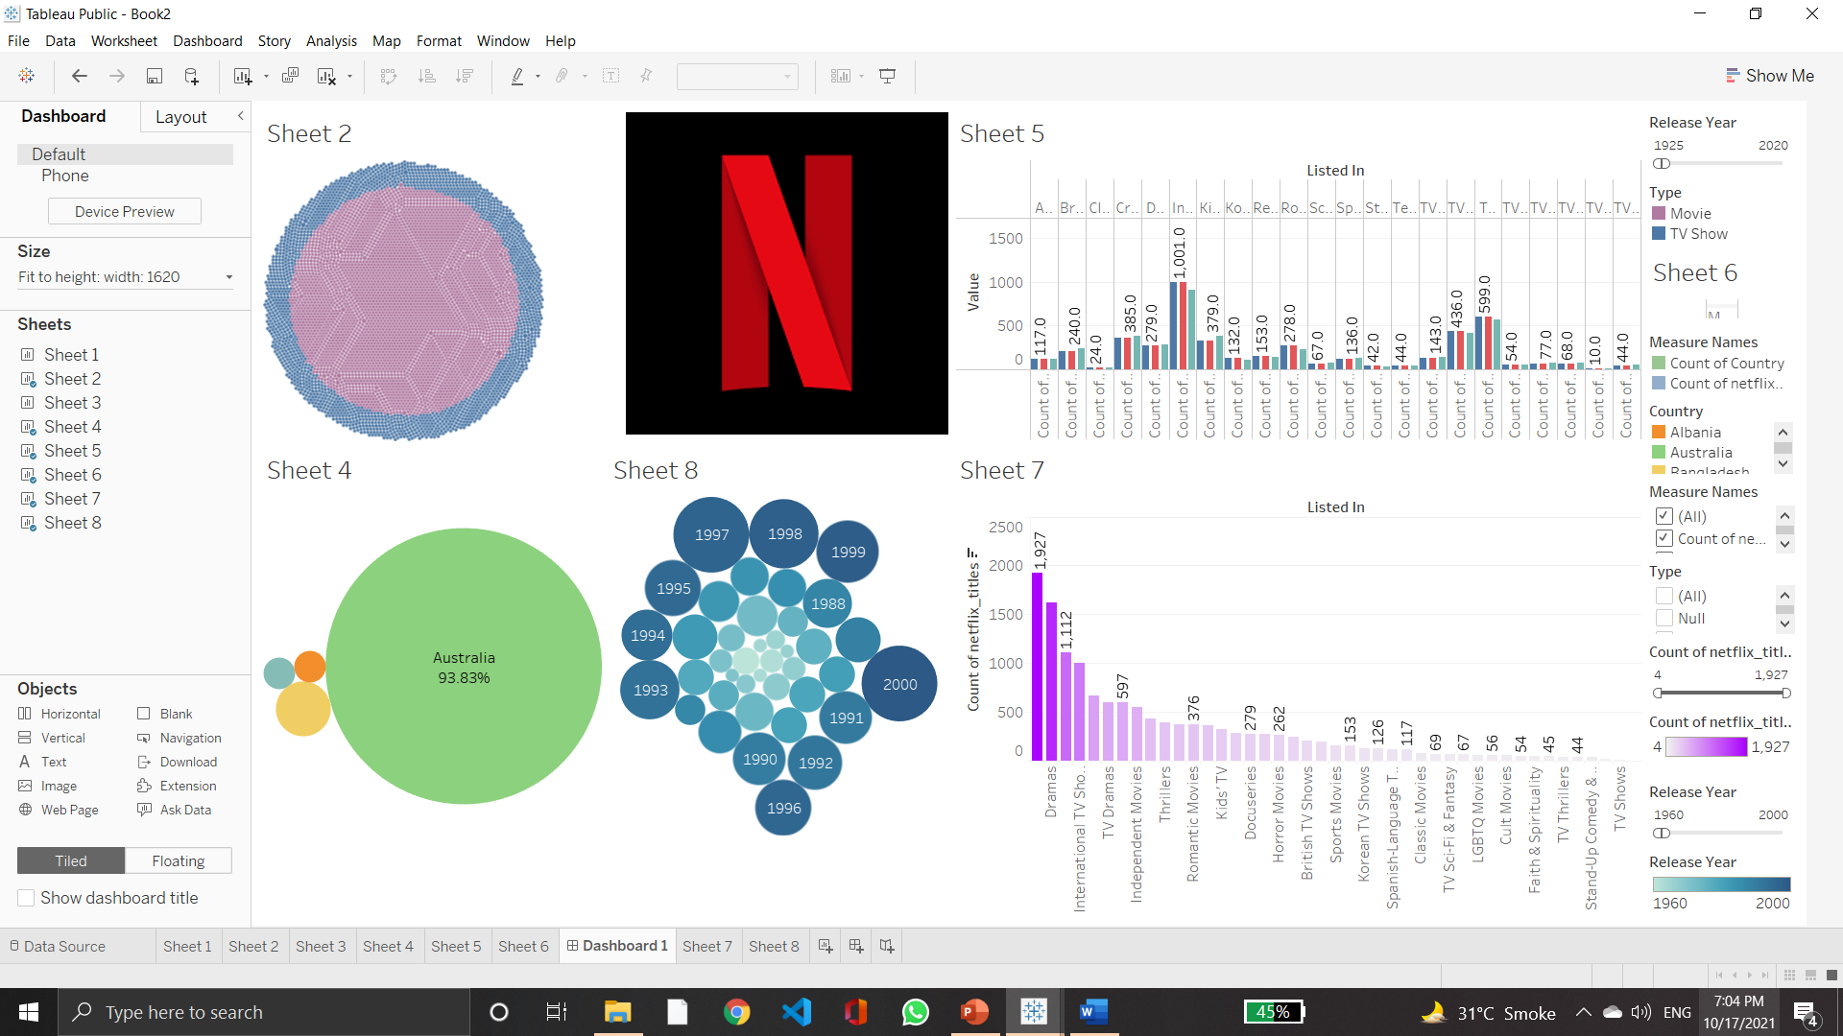
Create a dashboard with the most useful insights

